Slide 1


Production Revamp
Utilizing tech to streamline processes

Slide 2
Agenda
Introduction of Tools
Current Processes
Site Plan Interaction Menu
Implementation
Conclusion

Slide 3
GMF MISSION
To make money
Become a legacy
Kevin mission:
Make stuff so simple that I can grab someone off the street and they will be contributing to production by end of day.

Slide 4
Ongoing Tools
Connection Material Planner
In House Zeman Extractor
Fabrication/Weld Tracker
?
Manual Process: 1m45S per beam (40-50 beams) 75 min Avg
Version 1.0- reduces process to 25-30 minutes
Version 2.0 – Reduces process to 2-5 minutes
In house means no paywalls, no clunky support full room for improvement
Tracks Fab/Weld Status by Seq/Lot/Beams
Allows Plant Team to grab information within seconds reducing the need to run across.
Eliminates paperwork/
Interactive checklist of Material.
Equipped with dashboards and scripting
Reduces need for paper
Accelerates accountability, communication, reduces handling

Slide 5
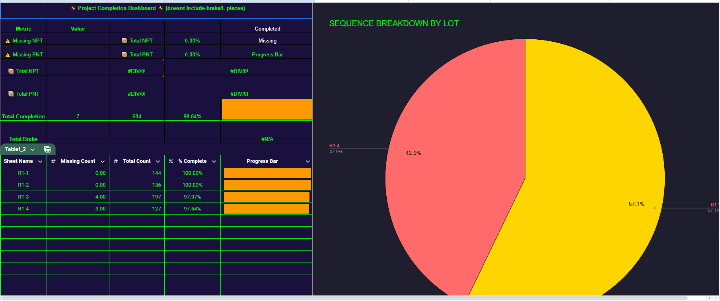
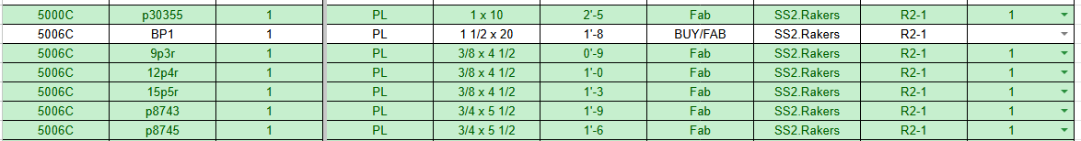
Ongoing Tools
Connection Material Planner
Interactive checklist of Material.
Equipped with dashboards and scripting
Reduces need for paper
Accelerates accountability, communication, reduces handling

Slide 6
Ongoing Tools
Connection Material Planner
In House Zeman Extractor
Fabrication/Weld Tracker
?
Manual Process: 1m45S per beam (40-50 beams) 75 min Avg
Version 1.0- reduces process to 25-30 minutes
Version 2.0 – Reduces process to 2-5 minutes
In house means no paywalls, no clunky support full room for improvement
Tracks Fab/Weld Status by Seq/Lot/Beams
Allows Plant Team to grab information within seconds reducing the need to run across.
Eliminates paperwork/
Interactive checklist of Material.
Equipped with dashboards and scripting
Reduces need for paper
Accelerates accountability, communication, reduces handling

Slide 7
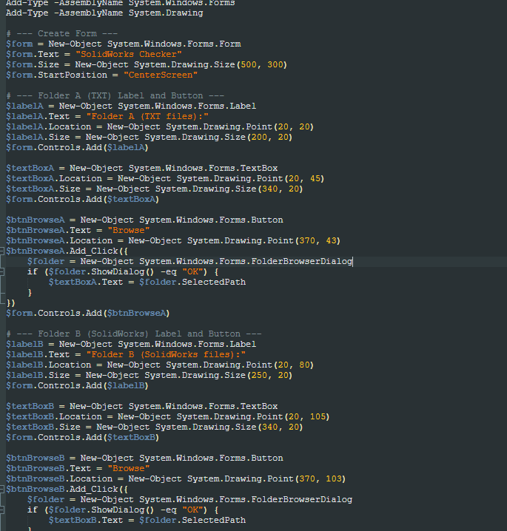
Ongoing Tools
In House Zeman Extractor
Manual Process: 1 min 45 Seconds per Beam
Version 1: 45 Seconds per beam
Version 2: 5-10 seconds per Lot
Assume A lot has 20-30 beams
Rakers 1: 29 Beams
Rakers 2: 35 Beams
USF: 281
MT:1775
Job | Manual | 1.0 | 2.0
Rakers 1 | 50 minutes 45 Seconds | 21 Minutes 45 Seconds | 30 Seconds
Rakers 2 | 1 hr 1 minute 15 seconds | 26 Minutes 15 Seconds | 40 Seconds
USF SS4 | 8 Hours 11 minutes 45 seconds | 3 hours 30 Minutes 45 Seconds | 2 Minutes
Milk Tanks | 51 Hours 46 minutes 15 seconds | 22 Hours 11 Minutes 15 Seconds | 6 Minutes
Speed: | Terrible | Better | Legacy

Slide 8
Ongoing Tools
Connection Material Planner
In House Zeman Extractor
Fabrication/Weld Tracker
?
Manual Process: 1m45S per beam (40-50 beams) 75 min Avg
Version 1.0- reduces process to 25-30 minutes
Version 2.0 – Reduces process to 2-5 minutes
In house means no paywalls, no clunky support full room for improvement
Tracks Fab/Weld Status by Seq/Lot/Beams
Allows Plant Team to grab information within seconds reducing the need to run across.
Eliminates paperwork/
Interactive checklist of Material.
Equipped with dashboards and scripting
Reduces need for paper
Accelerates accountability, communication, reduces handling

Slide 9
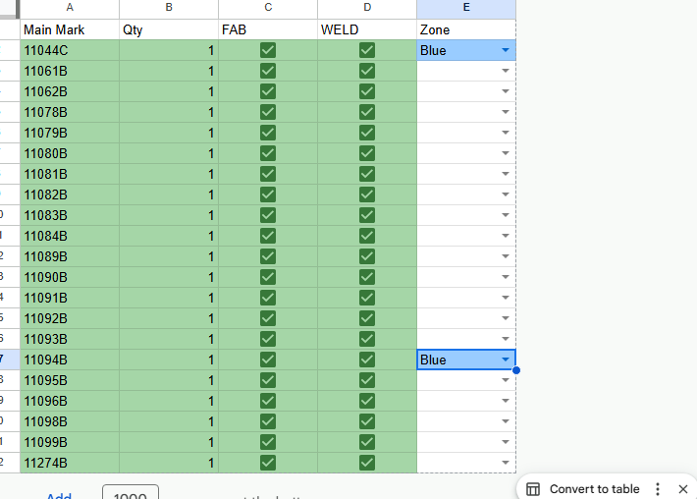
Ongoing Tools
Fab/Weld Tracking tool
Allows tracking on Main mark Fab and Weld progress in real time.
Eliminates having to run several reports on powerfab.
Eliminates unnecessary delay having to walk across the plant looking for people for updates.
Eliminate papers and incorrect reports
Talks to master Ship List (IP)

Slide 10
Ongoing Tools
Connection Material Planner
In House Zeman Extractor
Fabrication/Weld Tracker
Site Planning Tool
Manual Process: 1m45S per beam (40-50 beams) 75 min Avg
Version 1.0- reduces process to 25-30 minutes
Version 2.0 – Reduces process to 2-5 minutes
In house means no paywalls, no clunky support full room for improvement
Tracks Fab/Weld Status by Seq/Lot/Beams
Allows Plant Team to grab information within seconds reducing the need to run across.
Eliminates paperwork/
Interactive checklist of Material.
Equipped with dashboards and scripting
Reduces need for paper
Accelerates accountability, communication, reduces handling

Slide 11

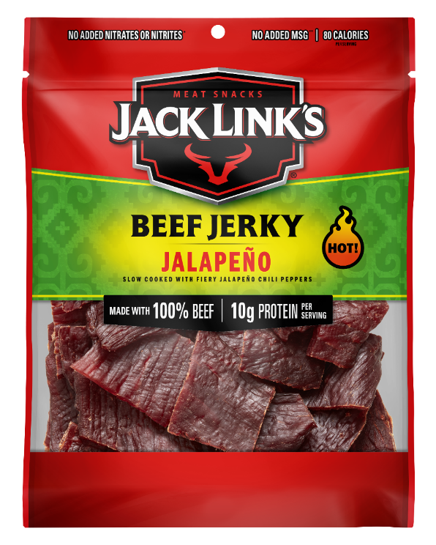
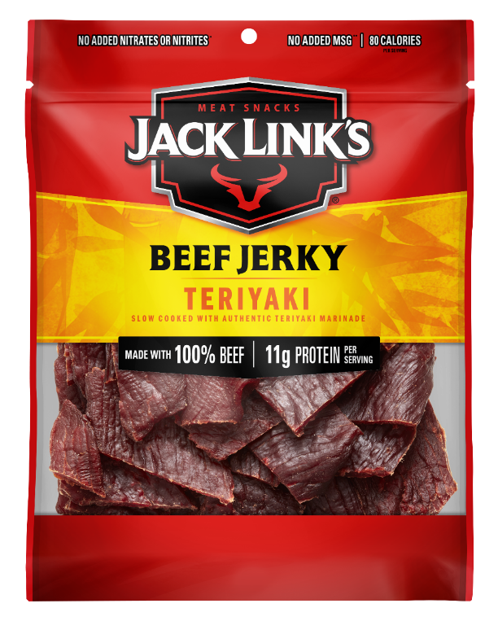
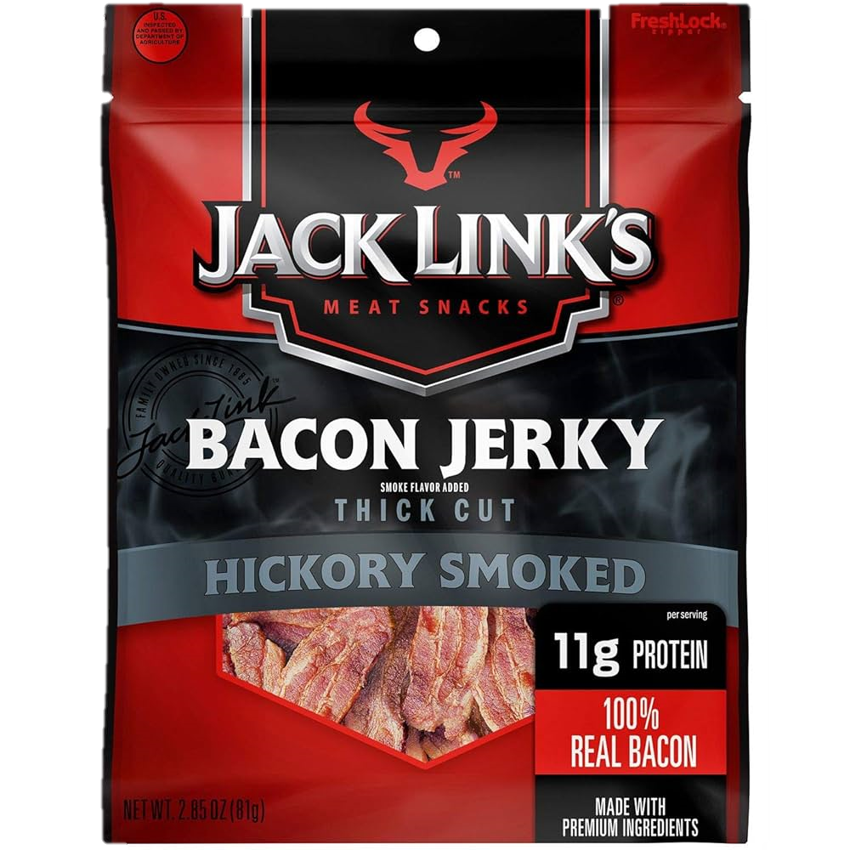
Ongoing Tools
Meet Sparky
He has been trained to sniff out different flavor beef jerky to locate material.
Red Zone: Teriyaki
Orange Zone: Jalapeno
Green: Hickory Smoke

Slide 12
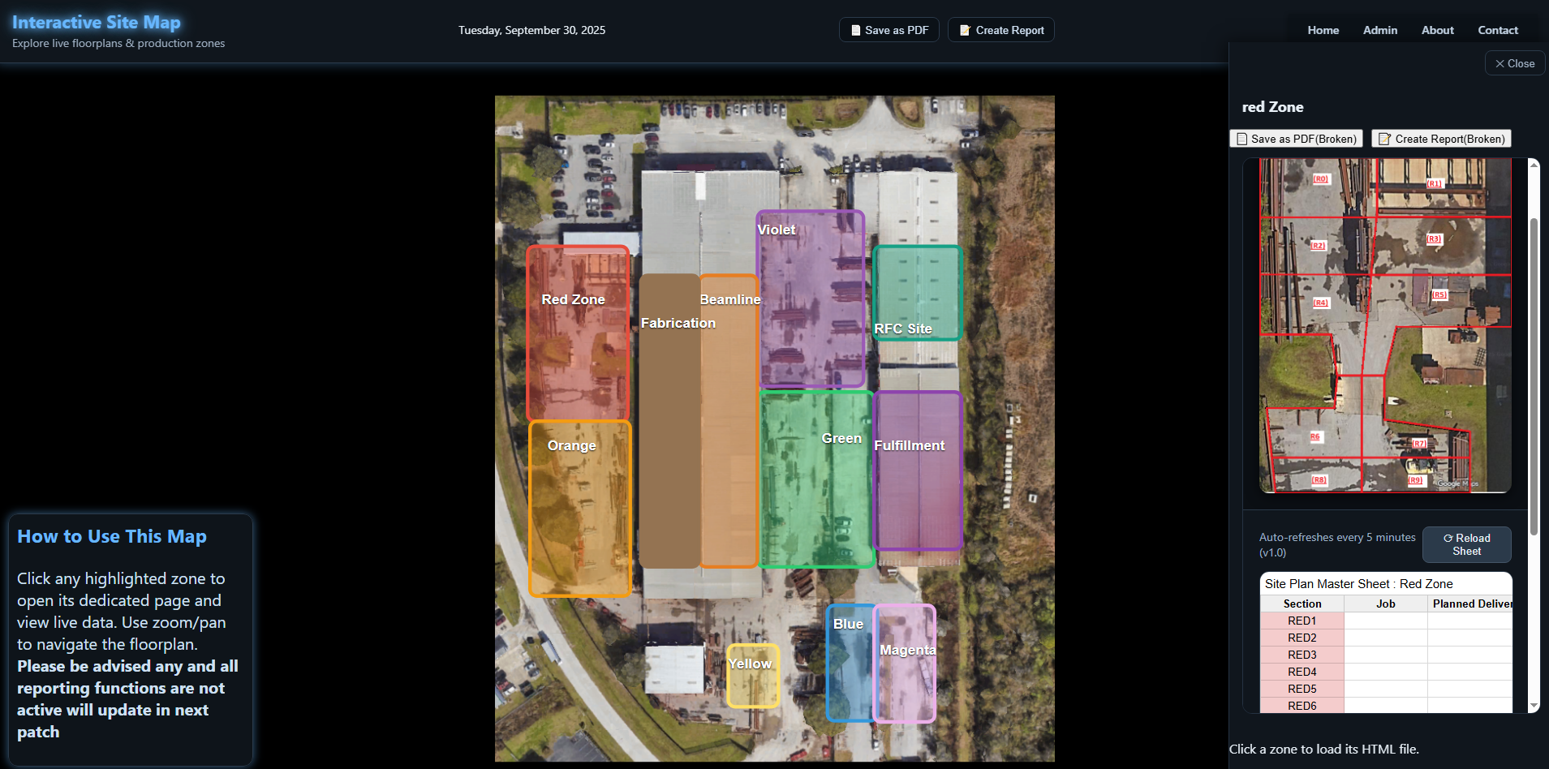
Site Planning Tool

Slide 13


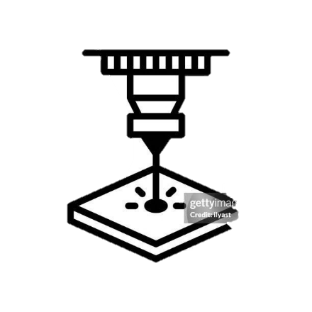

Timeline
Material Imported/Programmed
Material Cut
Material Fab/Welded
Prepped for shipping

Slide 14
Timeline
Connection Sorter Dashboard
Fab Weld Report
SitePlan Dashboard
Material Imported/Programmed
Optimizing Nesting Parameters for most efficient and waste reducing
Material Cut
Connection Material Dashboard accounts for location of material and completion
Material Fab/Welded
Fab/Weld dashboards allows for more efficient tracking of progress
Prepped for shipping
Site Plan Dashboard allows for easier locating of steel and faster problem resolution

Slide 15
Live Demo

Slide 16
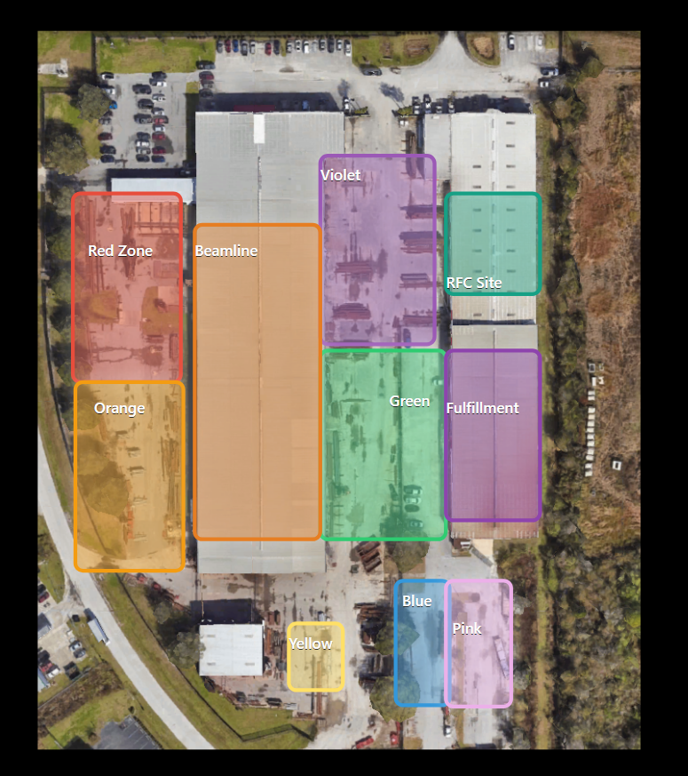
Summary
Detailed, interactive Site plan that lets you select locations and see detailed floorplans of each zone or shop.
Backend Data talks with each other allowing for one master flowchart of data similar to Powerfab
Potential Upgrades:
Removing 5 min delay and reducing it to 15 seconds minimum.
Creating a button on sorter material to create Fab Sheet (Eliminates Andrew having to go in)

Slide 17
Open Discussion

